Slide 1
GRAPH CUT SEGMENTATION

Slide 2
What Is Graph Segmentation?
❖ Graph Cut Segmentation is an advanced image segmentation technique that uses principles from graph theory to divide an image into distinct, meaningful regions such as foreground and background.
❖ The image is represented as a graph, where each pixel (or group of pixels) becomes a node, and connections (edges) between pixels represent similarity or neighborhood relationships.
❖ By modeling the segmentation task as a graph partitioning problem, the algorithm aims to find the optimal boundary that separates different regions of interest. This is done using a powerful technique known as the minimum cut / maximum flow algorithm, which determines the best way to "cut" the graph to isolate objects from the background.

Slide 3
WORKING
1.Graph Construction
The first step is to convert the image into a graph structure:
• Nodes (Vertices): Each pixel in the image becomes a node in the graph.
• Edges: There are two types:
o N-links (neighborhood links): Connect each pixel to its neighbors (typically 4 or 8-connectivity). These edges reflect the similarity between pixels — the more similar, the higher the edge weight.
o T-links (terminal links): Connect each pixel to two special terminal nodes — the Source (S) (representing foreground) and the Sink (T) (representing background)

Slide 4
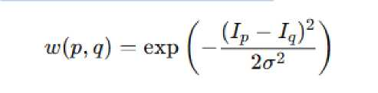
2. Edge Weights
Edge weights play a critical role in determining how the cut will be made:
• N-link weights are typically based on a similarity function like:
where Ip and Iq are intensities of neighboring pixels
sigma controls sensitivity.
This encourages the algorithm to avoid cutting between similar pixels

Slide 5
. T-link weights are based on how likely a pixel belongs to foreground or background. This can be determined through: o User input (like scribbles or bounding boxes) o Probability models (e.g., Gaussian Mixture Models for color histograms) - The higher the likelihood, the stronger the connection to that terminal node.
3. Source and Sink Nodes
Two terminal nodes are introduced:
• Source (S): Connected to pixels likely to belong to the foreground.
• Sink (T): Connected to pixels likely to belong to the background.
The goal is to decide for each pixel whether it should be connected to
the source or sink , whether it's part of the foreground or background.
4. Min-Cut / Max-Flow Computation
Now, the algorithm applies a min-cut / max-flow algorithm to find the optimal cut:
• A cut is a partition of the graph into two disjoint sets: one connected to the source, and the other to the sink.
• The minimum cut is the one with the smallest total edge weight between these two sets.
• This cut essentially "removes" the weakest connections (edges with low similarity) between pixels — ideally those between foreground and background.

Slide 6
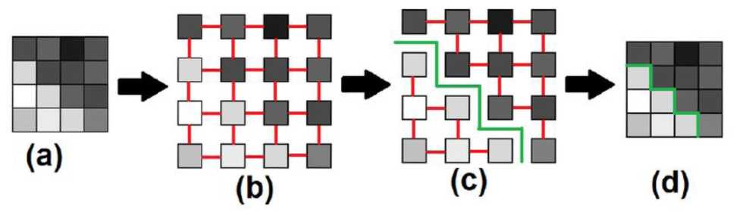
5.Final Segmentation
All pixels connected to the source node are labeled as foreground.
. All pixels connected to the sink node are labeled as background.
The result is a binary segmentation of the image based on the optimal boundary determined by the cut.

Slide 7
Advantages
1. Interactive Image Editing
Works great when users provide rough foreground/background hints. It refines the boundary accurately.
2. Medical Imaging
Effective for segmenting organs or tissues, especially with clear contrast and expert guidance.
3. Smooth Foreground-Background Separation
Performs well when object and background have distinct colors or textures.
4. Clean, Low-Noise Images
Accurate results in images without much noise or complex patterns.

Slide 8
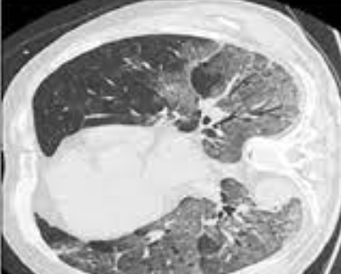

APPLICATIONS

Slide 9
Dis-Advantages
1. Cluttered or Textured Backgrounds
Fails when background looks too similar to the object.
2. Noisy or Low-Contrast Images
Struggles to find boundaries if the image lacks clear edges or is grainy.
3. Large Images or Real-Time Needs
Can be slow and memory-heavy for high-res or real-time applications.
4. Ambiguous or Weak User Input
Needs clear foreground/background hints — poor input leads to poor segmentation.

Slide 10


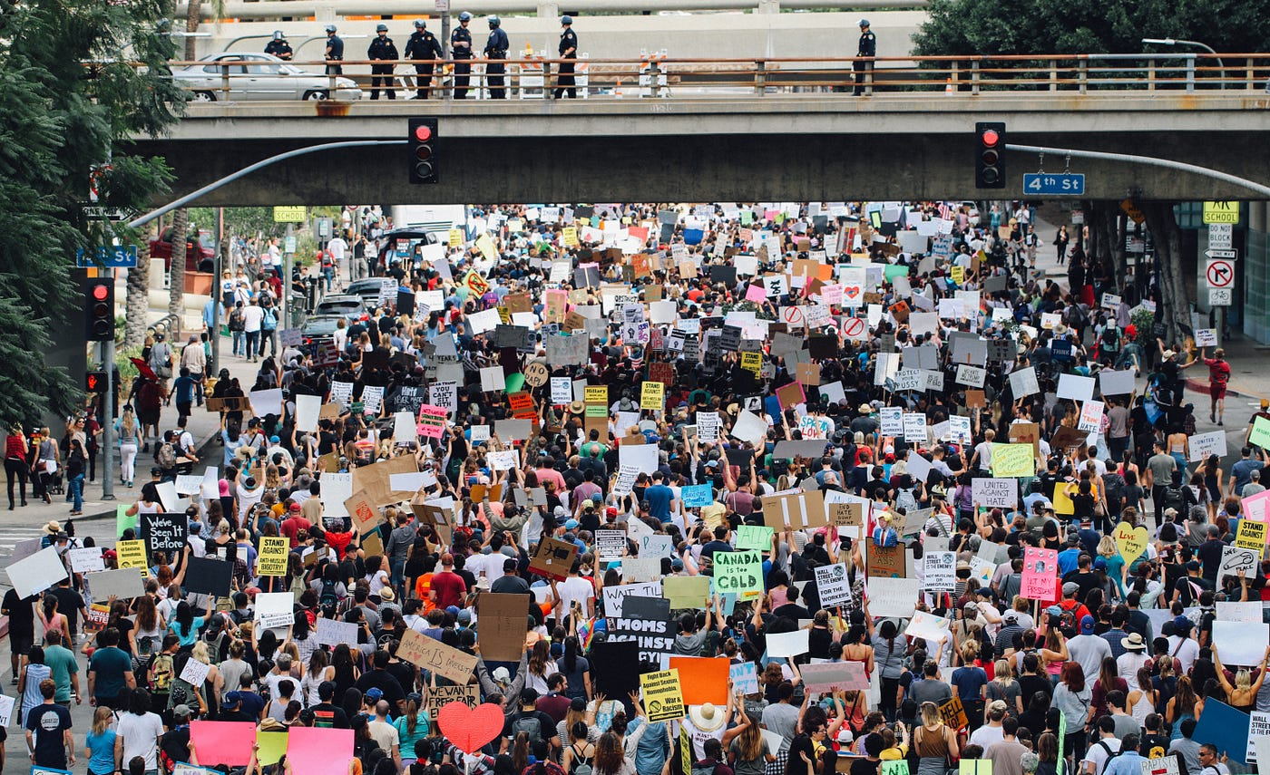
FAILURE CASES

